Slide 1

BIG MOUNTAIN REPORT
Data analysis on ticket pricing and suggestion

Slide 2
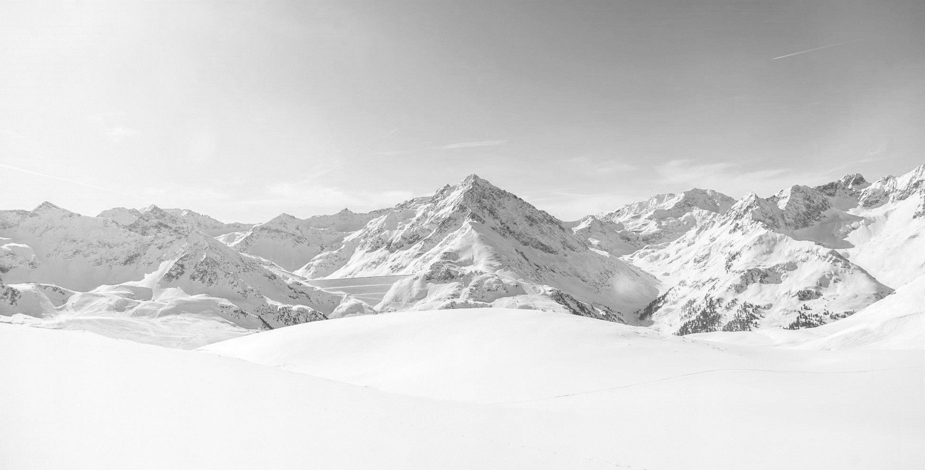
Contex
The business wants some guidance on how to select a better value for their ticket price. They are also considering a number of changes that they hope will either cut costs without undermining the ticket price or will support an even higher ticket price.

Slide 3
Criteria for success
Business want to either cut cost or find out what needed to be change in order to raise ticket price and attract more customer.

Slide 4

Summary
Big mountain ticket pricing right now is about undervalue base on the model prediction. As we find out on the model, Big Mountain Resort could price their ticket at $95.87 but the actual price is $81.00. Even with the expected mean absolute error of $10.39, this suggests there is room for an increase. However, this prediction is based on the feature of the chairlift, run, snowing and vertical drop. In order to make a good decision about price increase, Big Mountain resort should include more information about their customer and other expense such as hotel, relation between ticket price and customer purchase ticket, average profit per customer. The reason that the price increase in the ticket could be a bad decision for Big Mountain Resort if the total average profit per customer decrease more than the profit they get back from increasing the ticket price.

Slide 5
Additional
Based on our model, adding run and lifts will lead to increase revenue but just like increase the ticket price, it had the limitation. In the long run, Big Mountain Resort should increase their price but they can choose how to increase it bit by bit and gather more data from their customer to decide if they can add more run, lift to capture more ticket sale, or operation less lift, run to cut cost and increase profit.

Slide 6
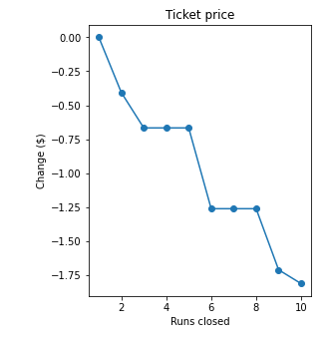
Additional
The model says closing one run makes no difference. Closing 2 and 3 successively reduces support for ticket price and so revenue. If Big Mountain closes down 3 runs, it seems they may as well close down 4 or 5 as there's no further loss in ticket price. Increasing the closures down to 6 or more leads to a large drop.

Slide 7
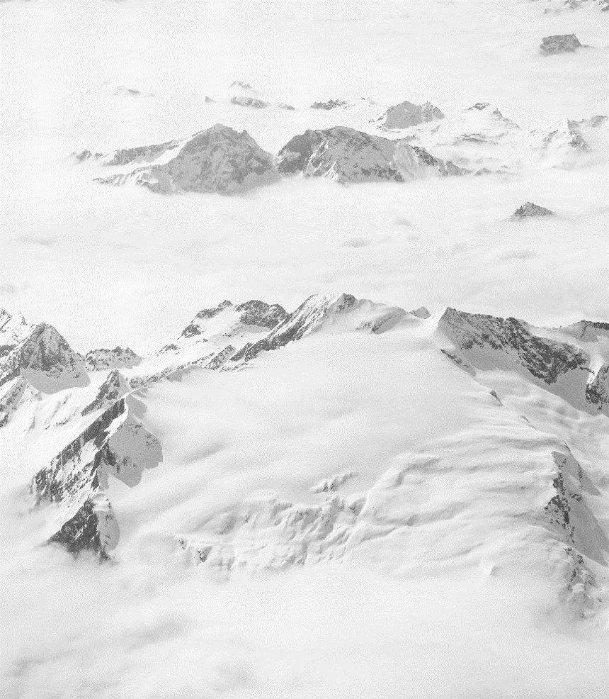
Stake holder
Thanh Nguyen : Data analyst
Jimmy Blackburn: Director of Operations
Alesha Eisen : Database Manager

Slide 8



Thank You
Thanh Nguyen
Nguyen.khac.thanh@me.com

